Slide 1
OS Admin
Scheduling Processes - Linux

Slide 2
Module objectives
After completing this module you will be able to:
Use the ‘crond’ utility to schedule regular processes
Use the ‘atd’ utility to schedule one off processes

Slide 3
Scheduling Processes
crond & anacron
atd

Slide 4
The crond utility
The crond utility is used to schedule processes that take place on a regular basis (i.e. Every day or every week).
Common uses of crond include
  Scheduling backups
  Scheduling removal of temporary files
  Scheduling regular reminders

Slide 5
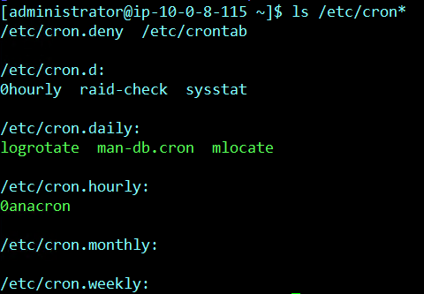
CRONTAB files
Lists of scheduled processes are stored in ‘Crontab’ files.
Crontab system file can be found in /etc/crontab
Root can edit this file to add the scheduled tasks.
In addition to cron.daily, cron.hourly, cron.weekly and cron.monthly directories, they contain scripts to run accordingly (once every day or every month or every hour).

Slide 6
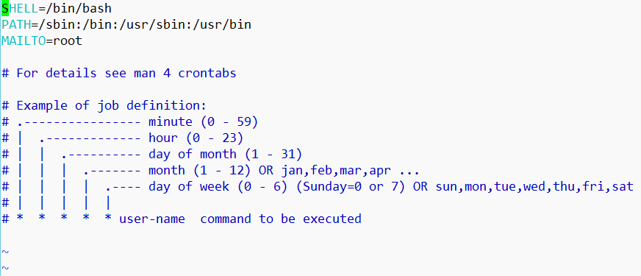
Contents of crontab files
Each line in a crontab file represents a single process schedule.
vi /etc/crontab
Notes:
We need to mention the user name that represents the user account that will be used to run the command or script
You can schedule command or script, redirect the output to a file otherwise the output will be mailed to the user mentioned in the MAILTO varaiable.

Slide 7
Lines in the crontab file
Field Description Values
1 Minute 0-59 or *
2 Hour 0-23 or *
3 Day of month 1-31 or *
4 Month 1-12 or *
5 Day of week 0-6 or * (0 is Sunday)
6 User-name
7 Command
Example:
0 18 1,15 * * root echo “Update your virus definitions” >/dev/console
Notes:
Example 1: * every minute or */10 --> every 10 mins
Example 2: 1-4 from Monday to Thursday or 1,4 this means Monday or Thursday

Slide 8
Examples of Crontab File Entries
# run five minutes after midnight, every day
5 0 * * * root $HOME/bin/daily.job
# run at 2:15am on the first of every month
15 2 1 * * root $HOME/bin/monthly.job
# run at 10 pm on sundays, reboot the server
0 22 * * 0 root /etc/shutdown -r

Slide 9
Editing crontab file by a normal user
To check if the user has a crontab file using:
crontab –l
To create or edit a crontab file use the following syntax:
  crontab –e
To remove the user crontab file:
crontab –r
Notes:
Login as any user and then type crontab –l to see if that user has scheduled tasks, or use crontab –e to schedule a task for this user, or use crontab –r to delete the scheduled task of this user

Slide 10
Controlling access to crontab
We don’t necessarily want everyone to be able to schedule processes.
Use the cron.deny file to specify who should not use crond to schedule processes.
This file is found in /etc/cron.deny

Slide 11
Limitations Of Crond
crond jobs run within a defined time zone only as specified by the system clock.
crond job syntax does not make it possible to define all possible periods one could think of. E.g. It is difficult to express the last week of the month.
crond job runs on specific time so if the server is down during that time the job won’t run.
Files or directories which are created by crond jobs are only created with default permissions as specified by the umask setting.
To send an email in a crond job you need to specify the MAILTO environment variable.
Notes:
crond job runs on specific time so if the server is down during that time the job won’t run.

Slide 12
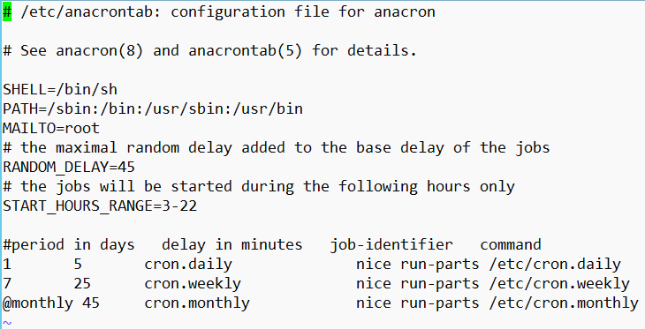
The anacron utility
To schedule a job to run daily, weekly or monthly within a certain delay from the system start-up.
It used exactly like the crond:
vi /etc/anacrontab
Notes:
crond job runs on specific time so if the server is down during that time the job won’t run so to overcome this issue you can use anacron inteasd.
1 = daily and the job will run after 5 minutes from the system startup
7 = weekly

Slide 13
Scheduling Processes
crond & anacron
atd

Slide 14
The ‘atd’ utility
The ‘at’ utility allows you to schedule a one off task.
An example of the ‘at’ command might be to send yourself a reminder.
The ‘at’ service must be working to be able to use the ‘at’ command, which we can check using:
We can also deny the use of ‘at’ for certain user by adding that user name to the file /etc/at.deny

Slide 15
Creating an ‘atd’ job
Use the following syntax:
at <date/time>
and then type each command you want to schedule on separate line
once you finished press Ctrl+d
Example:
at noon
ls /etc > /testAT
Ctrl+d
Notes:
It can be also:
at 4:30pm
at wednesday

Slide 16

Other uses of ‘at’
atq check which jobs are in the at queue.
at –l check which jobs are in the at queue.
at –r <job number> remove an at job.

Slide 17
Exercise 5 – Scheduling Processes
UNIX OS Admin Exercises
Notes:
Please refer to the MS OS Admin Exercises 2017 document on the LMS

